Slide 1
Medication Adherence Support System
Patient-Facing App Progress Report
CS 6440: Introduction to Health Informatics - Fall 2016 - Georgia Tech
FHIR STOP is...
Arnab Barua
Adam Hachey
Mark Mullison
Dominick Roselli (Narrator)
Jiankun Sun
Notes:
Hi, I’m Dominick Roselli with Team FHIR Stop, and this is our Progress Report.

Slide 2

Medication Adherence - What’s the Problem?
“Drugs don’t work in patients that don’t take them.” - Former US Surgeon General Dr. C. Everett Koop
Medication Adherence is the degree to which a patient adheres to a prescribed medication regimen.
In 2010, Non/Low-Adherence caused an estimated 125,000 deaths and cost US$290 billion*
*The 21st Century Intelligent Pharmacy Project: The Importance of Medication Adherence, 2010, Center for Health Transformation, page 1.
Notes:
We’re working on the Medication Adherence problem.
People not taking their meds as prescribed costs lives and money. It causes medical complications and even death. It also drives up health care costs in a number of ways including increasing the number of
Hospitalizations and nursing home admissions.

Slide 3
Medication Adherence Support System (MASS): Conceptual Architecture
Notes:
It's is a big, multi-part problem… and there’s lots of value in solving it.
So some folks from the Centers for Disease Control wrote a project proposal to help do that. We took their proposal as our challenge and developed the conceptual architecture you see here. This was discussed in detail in our Technical Presentation, so we won’t spend much time on this slide today.
There is one update which came out of further discussions with Skip Cleland and Renee Robinson at the CDC since our technical presentation. That was the addition of a Public Health Professional UI to allow them to inspect medication adherence propensity and key factors that influence it at the community level with no individually identifiable information (that’s component #6 in this diagram). Now this new component…and in fact, most of what’s on the diagram... is out of scope for this semester. But we think it’s important to consider this context when looking at our work, which will focus exclusively on the patient facing app (that’s #1 on this diagram). We did want to highlight that we’ve spent some time on this overall architecture. The CDC folks have told us that they find this very useful and plan to use it to inform future development projects, so we’re happy with the progress on this and it represents a significant amount of work.

Slide 4
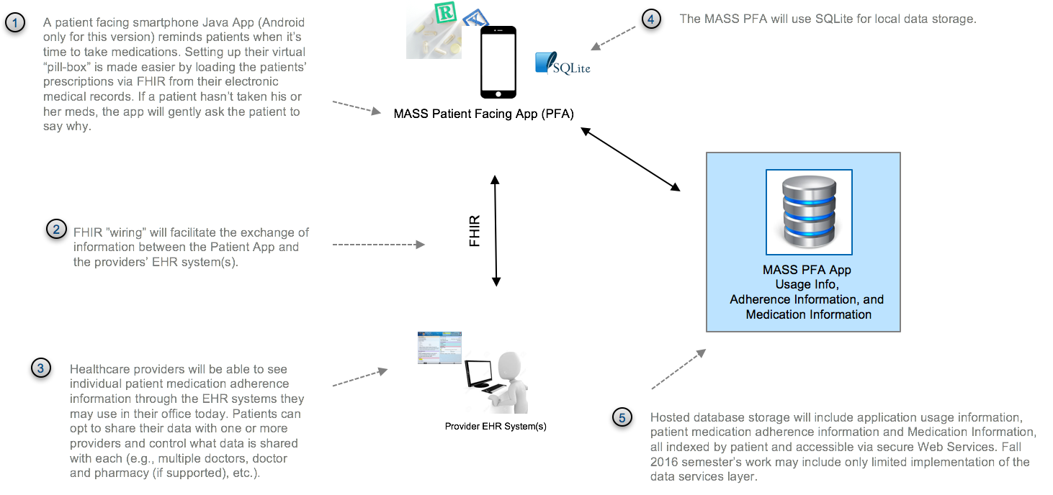
MASS Patient Facing App - Architectural Overview
Notes:
Here’s what the patient app architecture looks like…as I said, this is this semester's focus. We want to note that we will not have time to implement the hosted central database shown on this slide (that’s #5 on the diagram). There will still be a local database on the Android client and the app will get medication orders from, and push information via FHIR to, simulated provider EMR systems.

Slide 5
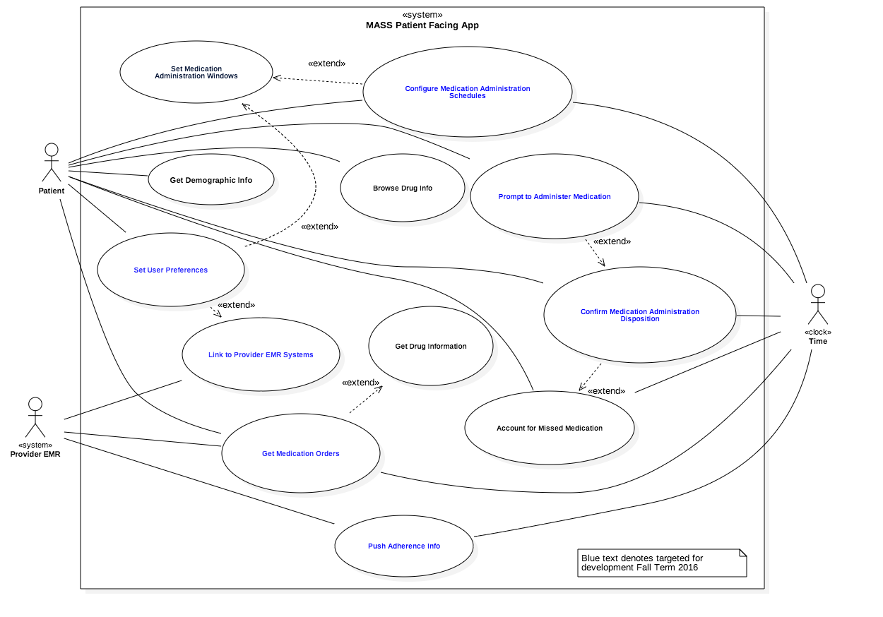
Use Case Diagram
12 Use Cases
7 prioritized for this semester
(in Blue)
Notes:
The Diagram on this slide catalogs the Patient Facing App’s Use cases.
Details about these are included in our GitHub Repo in a markdown file called UseCaseModel.md in the Technical Presentation Folder. Since we shared our technical presentation, we added another Use Case at the request of Renee Robinson at the CDC. She thought it would be a good idea to gather demographic information from the patients using the app in order to help better understand factors influence medication adherence, and to augment data available from sources like Census information. The information she asked we gather are things like How many people are in their household, how many jobs they might have, Education, Primary Language (if not English), and Visual hearing or mobility impairment. That information will be sent back to the MASS central database. We think this is a great idea, but we may not have the time to get to it in the next three weeks, which is a great segue into a detailed discussion about our current status. Note on this slide that the use cases in Blue have been prioritized for development this semester

Slide 6
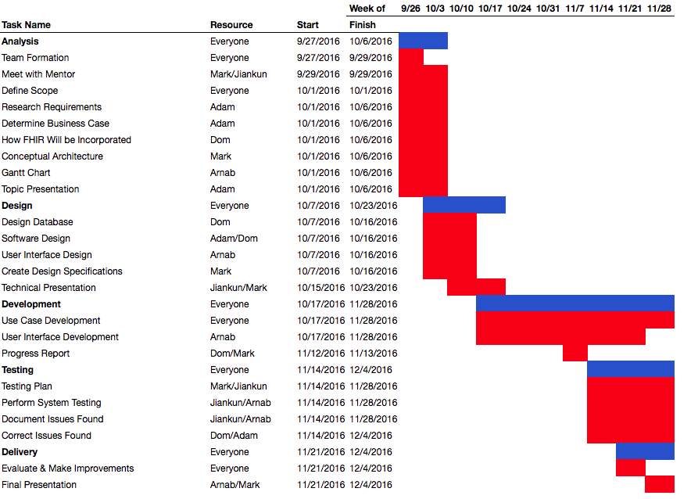
Notes:
Here’s our current Project Plan. We said in our last update that we were following an Agile process and that we wouldn't know exactly how far we’d get with the features until we were another week or two in and could measure our velocity. We’re finally getting down to being productive with the actual construction and we have two use cases well underway.
So we’ve made progress more or less according to our schedule, but this project plan has been updated since our last briefing.
In summary, we’ve…
Further refined our Conceptual Architecture
Further refined and prioritized the Use Cases
Worked through technical difficulties of setting up a FHIR server
Setup Android Studio Project Structure in our repo
Refined our class diagram and started implementing the classes we identified in it.
Made good progress on two use cases
We’ve still got one big challenge, and that’s that we’re making very slow progress in figuring out how to extend FHIR resources. To work through this, we’ve posted on Piazza and will continue research on how to best implement extensions.
Overall velocity is ramping quickly and should pick up quite a bit next week.

Slide 7
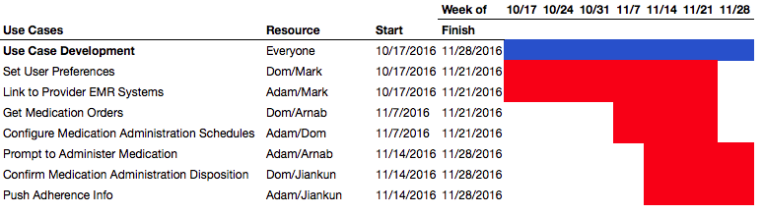
Notes:
This slide will help us get more specific about exactly what’s going on over the next few weeks and how far we plan to get with the Patient Facing App including where we plan to be when we wrap up the project.
The use cases shown here are all of the ones that were highlighted in “Blue” in the use case diagram a few slides back—these are what we plan to get done from a coding perspective this semester. You can see here how the development will be progressing. You can check out our GitHub repo to track the latest updates and see how the code base is developing. There is still some risk that we won’t get through all of these depending on velocity, but we’re all committed to working hard to get through these and will do our best.

Slide 8
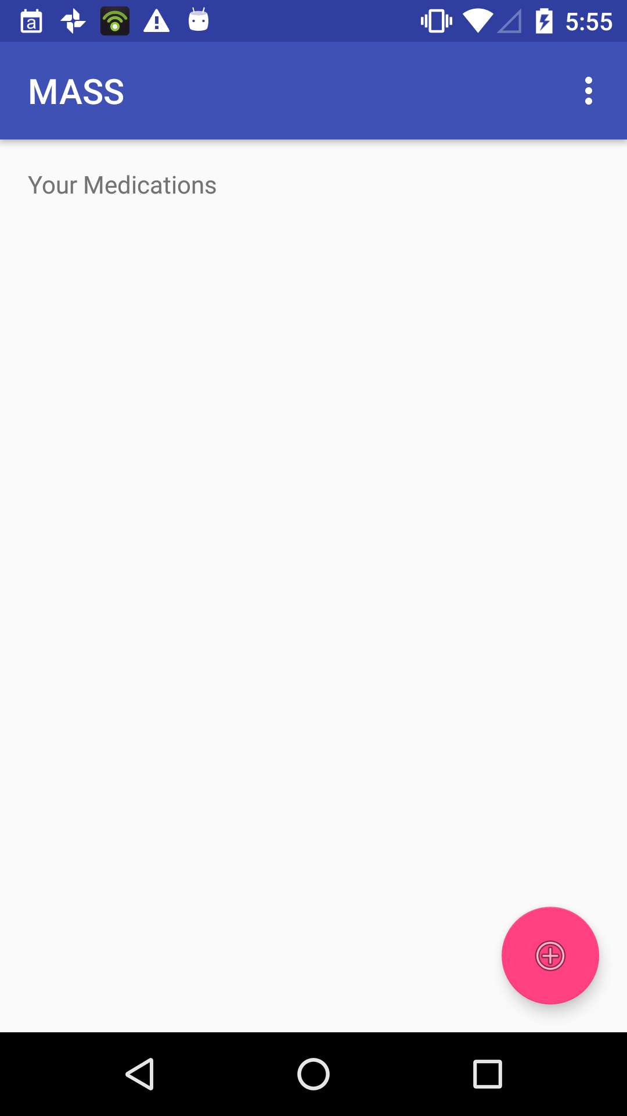
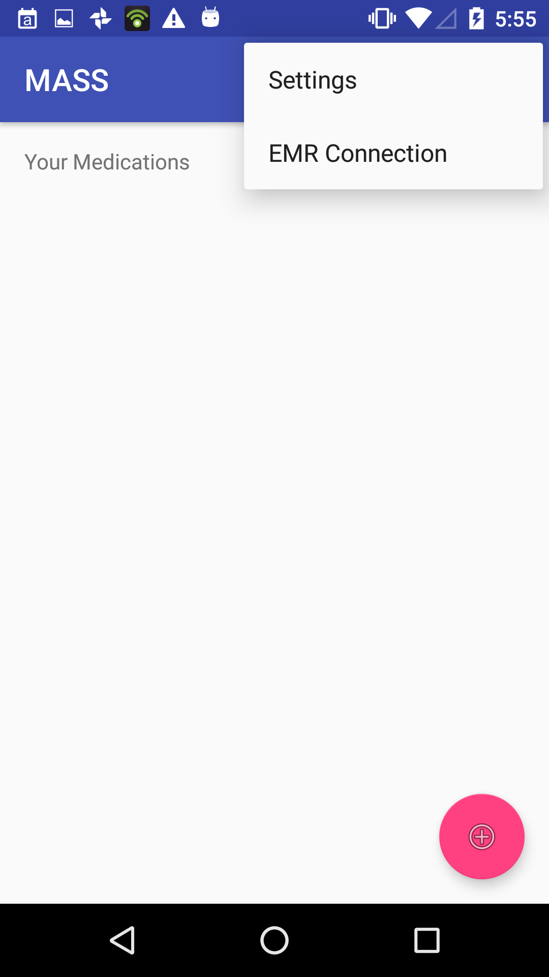
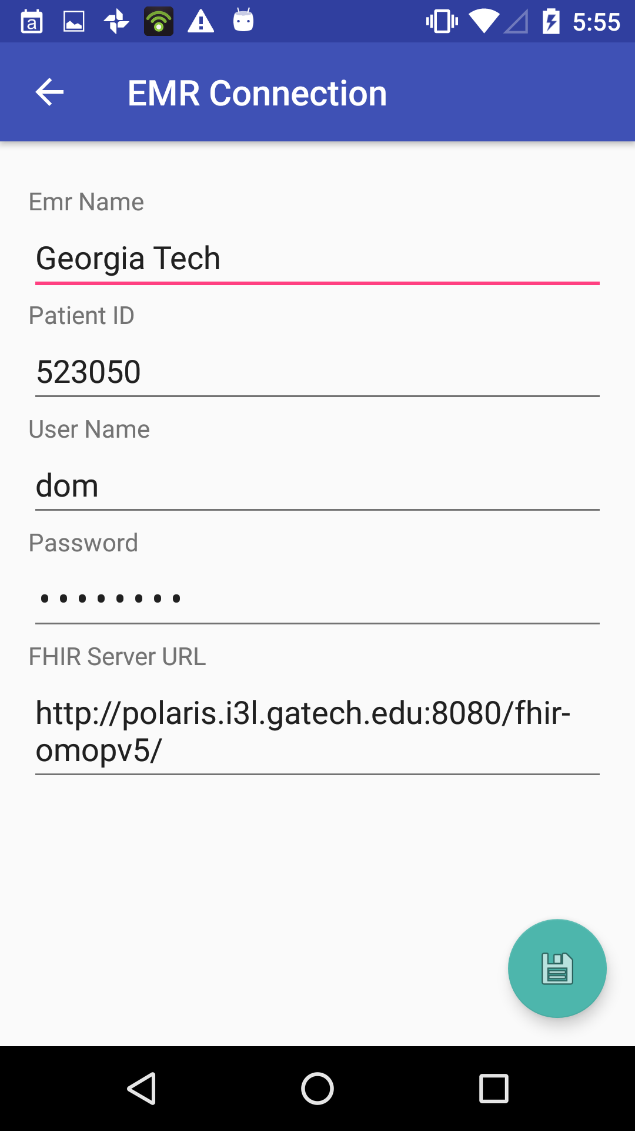
MASS Patient App - Link to Provider EMR Use Case Screens
Notes:
As mentioned, we’ve made a lot of progress in setting things up and getting going, but we’re just starting to see the fruits of that labor in terms of actual code construction.
Here are a few screenshots from our app. These look different than the mock-ups we did previously, because these are actually live (and we’ve been challenged a little bit in making Android do what we’d like since none of us are Android developers!) Right now, the use case that is closest to being completed is the Link to Provider EMR Systems shown above. The rest of the work has been backend planning, research and setup. But we are expecting that to pick up quite a bit next week, and plan to come close to the use case implementation that we showed on the last slide. It’s actually taken quite a bit of work to get the scope and the development platform figured out… and frankly, there’s still work left there. But it’s going along well now and we’re looking forward to ending with a good demo that shows how FHIR resources can be used to help improve medication adherence. Given our clear focus on implementing Use Cases, we expect things to pick up quite a bit next week.
That’s all we had to share with you. We hope you found that at least a little bit interesting.

